Slide 1
Validating ID Submissions using Computer Vision
Improving the customer experience in applying for a new digital bank account

Slide 2
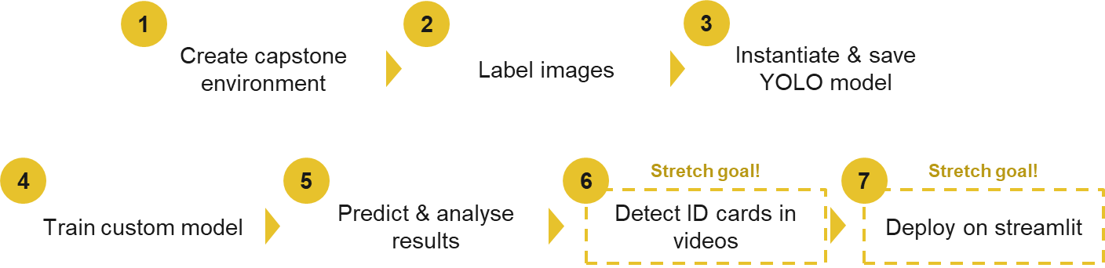
Progress update (20 Feb 2023)
 | What’s done | What’s next (before next update)
Business case | Indonesia’s banking population, market size Benefits of digital KYC How banks promise to open accounts in 5 mins (video call, SingPass equivalent) | Decide between object detection / classification Take a pause after, sort out the coding portion first
Modelling | Label 250 out of 1000 data (25%) Found updated reference to use YOLO model (expriencor YOLOv3 → Ultralytics YOLOv5) Updated environment, labelling tool | Complete labelling today Try to get baseline model predictions

Slide 3
Progress update (22 Feb 2023)
Baseline model done!
 | What’s done | What’s next (before next update)
Business case | Decided on object detection (identifying ID card vs passports) | Pause, focus on technical portion first
Modelling | Labelled 100% of data (1K photos) Baseline model done using transfer learning (using pytorch) | Baseline score too good (dataset too clean?) Try other model params Try building classification model (?) Try streamlit (?)
Key question:
Should I tweak the dataset / model further, OR
Move on to streamlit / understanding the theory of how YOLO works

Slide 4
Scores (Baseline)
Dataset: 500 photos of ID cards, 500 of passport
Train-val-test split: 80-10-10 (v7, Feb 23)
Preprocessing: Stretch image to 640 x 640 pixels (required by YOLO)
Augmentation: None
Batch: 8 (capped by my hardware)
Epochs: 100
Weights: pretrained YOLOv5l on COCO
Freeze: 10 layers (backbone of YOLO)
Digitally generated, 10 of each:
ID Cards (500): Albania, Spain, Estonia, Finland, Slovak Republic,
Passports (500): Russia, Republic of Serbia, Latvia, Greece, Republic of Azerbaijan
Auto-selected by Roboflow
Train -> 381 : 419 (card : passport)
Val -> 81 : 19
Test -> 38 : 62
Note: there is room for improvement (e.g. stratify, hide 1 or 2 nationalities in test set from train/val

Slide 5
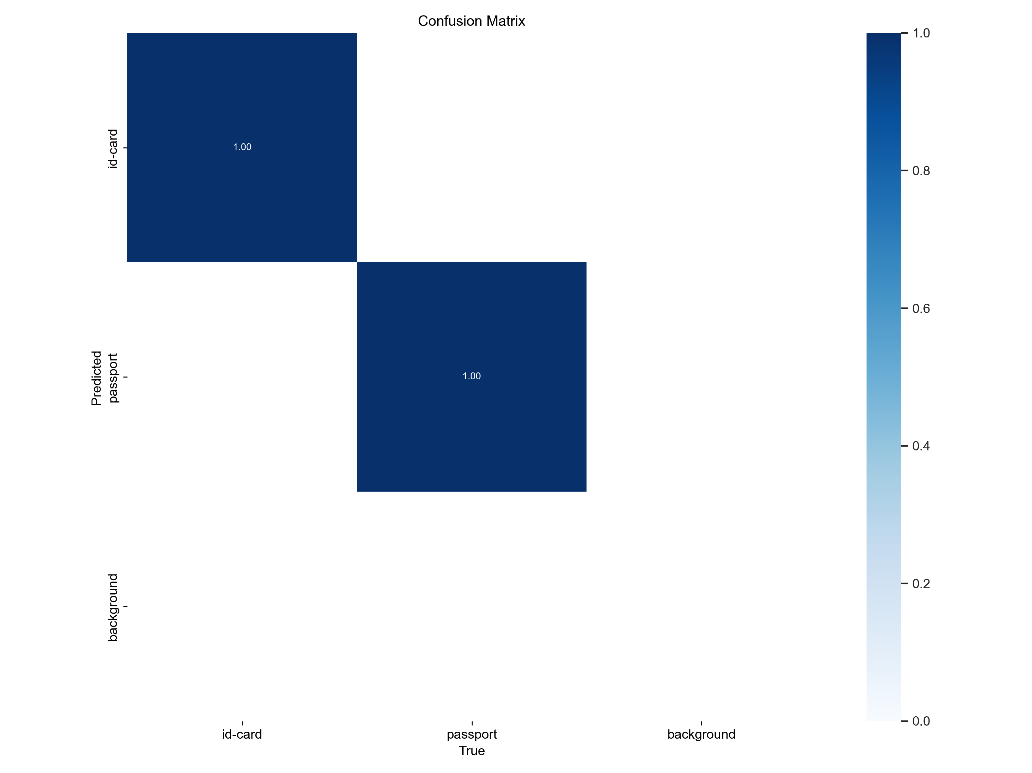
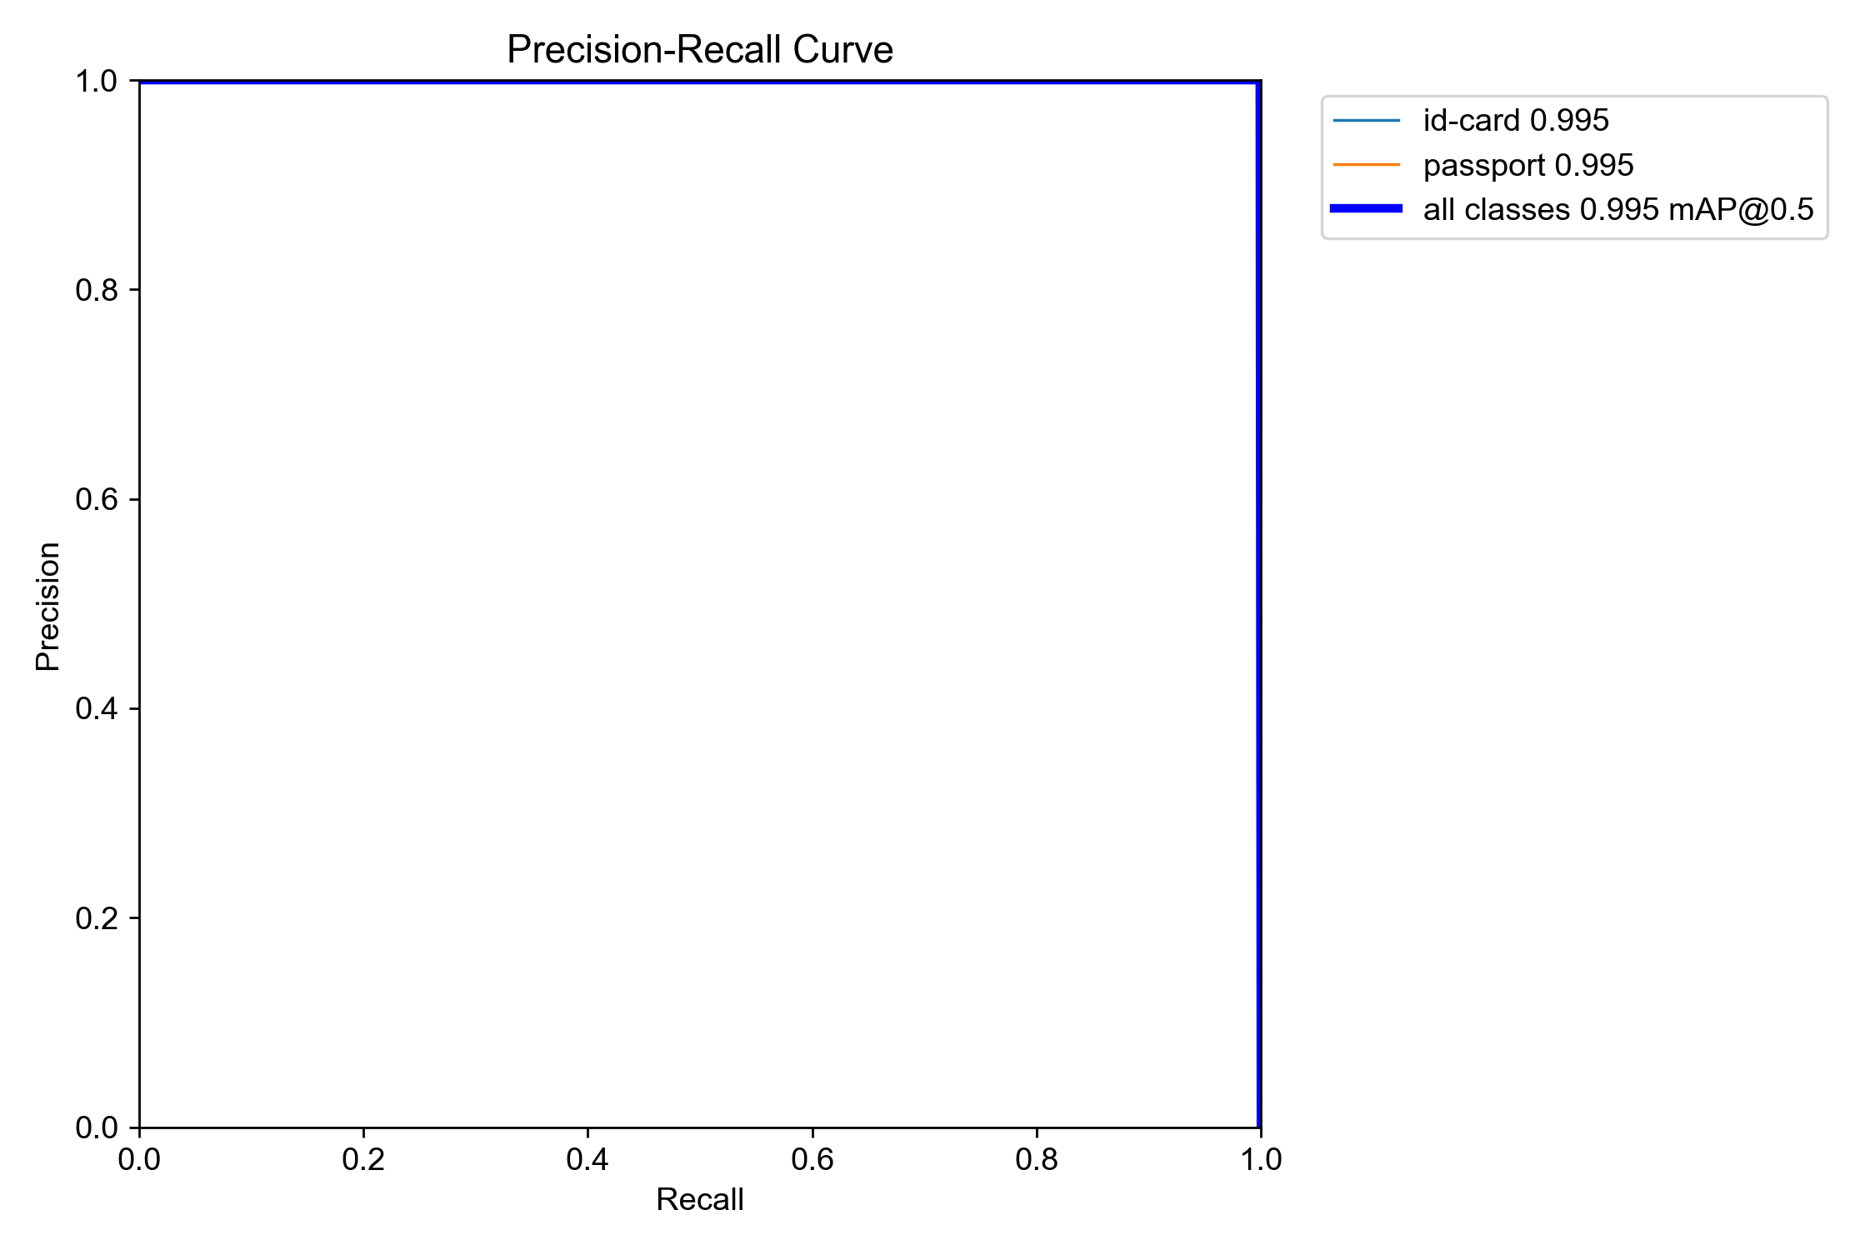
Prelim analysis:
perfect score? Overfit? Not enough variation in dataset?

Slide 6
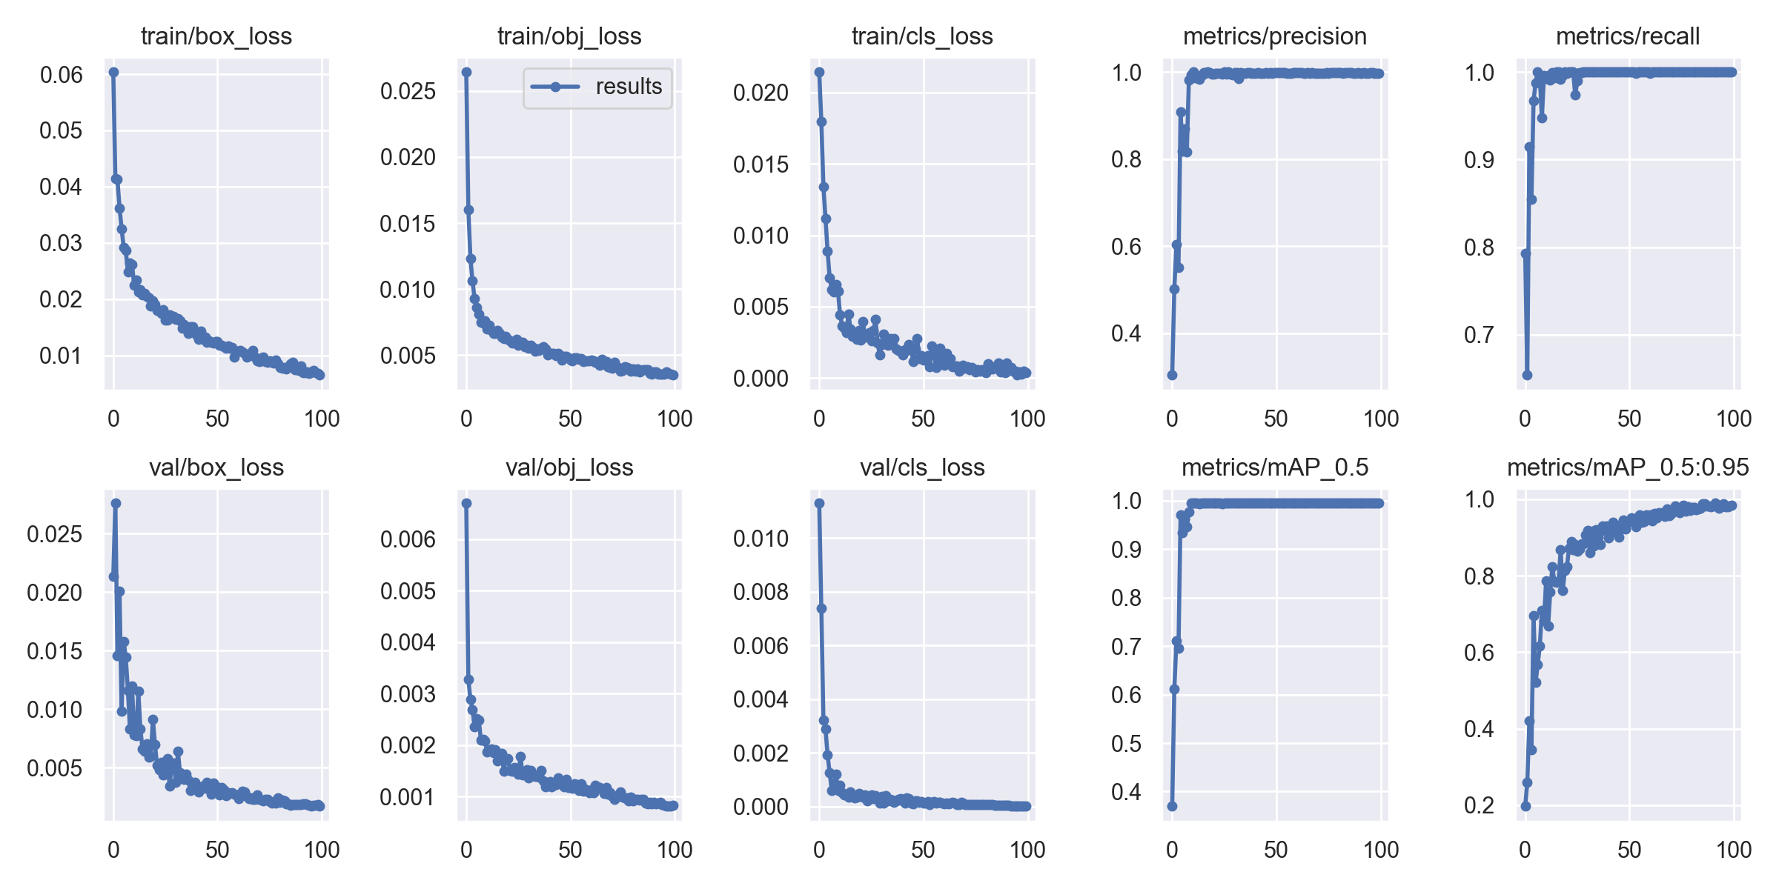
Very low losses in general
Near-Perfect Precision/Recall
mAP_0.5 = ~1 after ~10 epochs

Slide 7
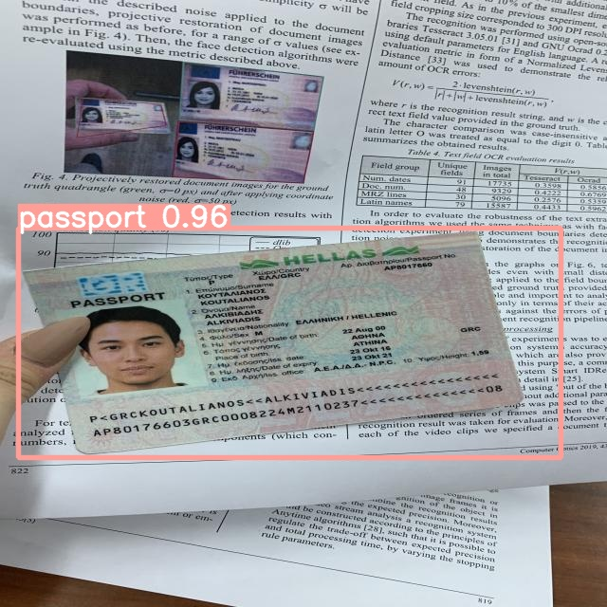
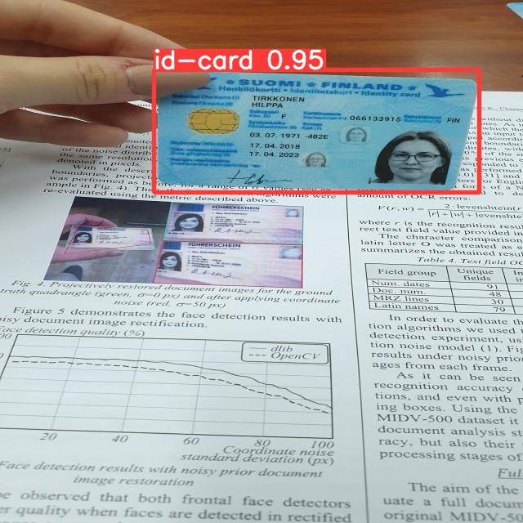
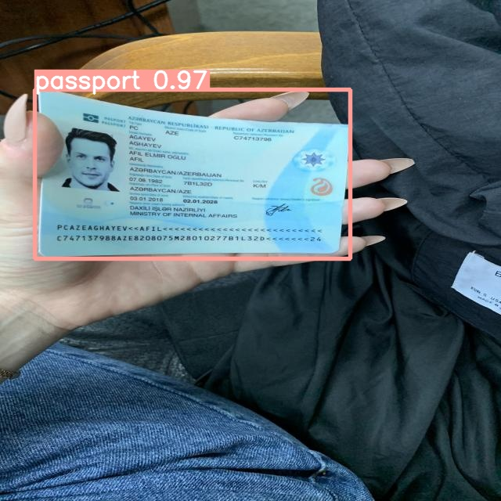
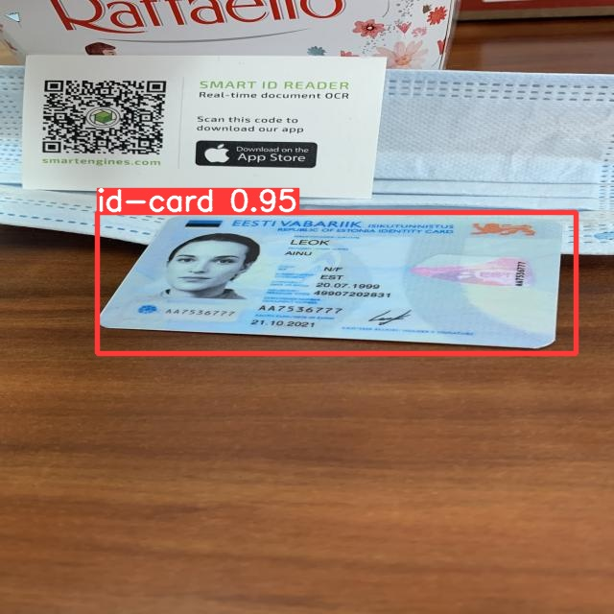
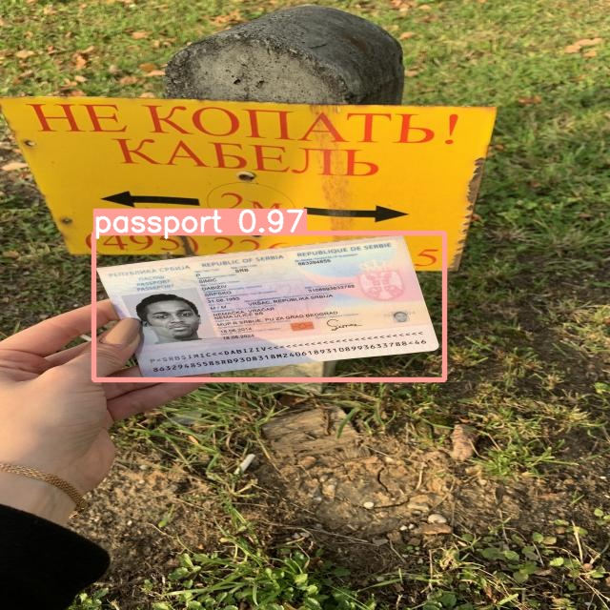
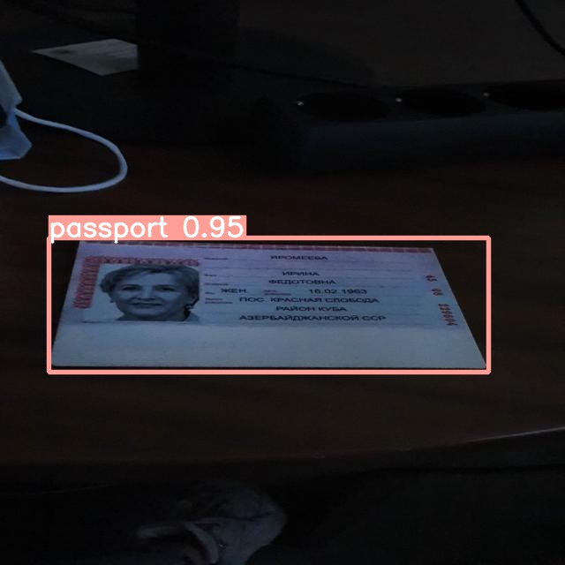

Slide 8
Scores (Improved Model 1)
Dataset: 500 photos of ID cards, 500 of passport
Train-val-test split: 60-20-20 (v7, Feb 23)
Preprocessing: Stretch image to 640 x 640 pixels (required by YOLO)
Augmentation: None
Batch: 8 (capped by my hardware)
Epochs: 100
Starting weights: pretrained YOLOv5l on COCO
Freeze: 10 layers (backbone of YOLO)
Same
20% in test so that I can hide 1 nationality of ID cards (100 photos) and 1 nationality of passport (100 photos) from the test-val dataset
Different
Same
Same
Same
Same
Same
Same
*: gamma exposure: changes the intensity of light of grays while keeping full black and white true (as opposed to brightness, which raises/lowers intensity of light across all colours)

Slide 9
Scores (Improved Model 2)
Dataset: 500 photos of ID cards, 500 of passport
Train-val-test split: 60-20-20 (v7, Feb 23)
Preprocessing: Stretch image to 640 x 640 pixels (required by YOLO)
Augmentation:
Crop: 0% minimum zoom, 10% maximum zoom
Rotation: between -15º to +15º
Brightness: between -10% and +10%
Exposure*: between -7% and +7%
Batch: 8 (capped by my hardware)
Epochs: 100
Starting weights: pretrained YOLOv5l on COCO
Freeze: 10 layers (backbone of YOLO)
Same
Different
Same
Create variation in dataset??
Different
Same
Same
Same
Same
*: gamma exposure: changes the intensity of light of grays while keeping full black and white true (as opposed to brightness, which raises/lowers intensity of light across all colours)

Slide 10
Scores (Improved Model 3)
Dataset: 500 photos of ID cards, 500 of passport
Train-val-test split: 60-20-20 (v7, Feb 23)
Preprocessing: Stretch image to 640 x 640 pixels (required by YOLO)
Augmentation: None
Batch: 8 (capped by my hardware)
Epochs: 100
Starting weights : pretrained YOLOv5l on COCO
Freeze: 0 layers
Same
Different
Same
Same
Same
Same
Same
Not sure about this one – do I need further training if the transfer learning is so good?
Different
*: gamma exposure: changes the intensity of light of grays while keeping full black and white true (as opposed to brightness, which raises/lowers intensity of light across all colours)

Slide 11
Scores (Improved Model 4)
Dataset: 500 photos of ID cards, 500 of passport
Train-val-test split: 60-20-20 (v7, Feb 23)
Preprocessing: Stretch image to 640 x 640 pixels (required by YOLO)
Augmentation:
Crop: 0% minimum zoom, 10% maximum zoom
Rotation: between -15º to +15º
Brightness: between -10% and +10%
Exposure*: between -7% and +7%
Batch: 8 (capped by my hardware)
Epochs: 100
Starting weights: pretrained YOLOv5l on COCO
Freeze: 0 layers
Same
Different
Same
Different
Same
Same
Same
Not sure about this one too
Different
*: gamma exposure: changes the intensity of light of grays while keeping full black and white true (as opposed to brightness, which raises/lowers intensity of light across all colours)

Slide 12
Progress update (24 Feb 2023)
4x models done!
 | What’s done | What’s next (before next update)
Business case | Pause, focus on technical portion first | Pause, focus on technical portion first
Modelling | Baseline + 3 improved models | Model pruning? E.g. 0.3-0.5 sparsity (dropout) Try streamlit

Slide 13
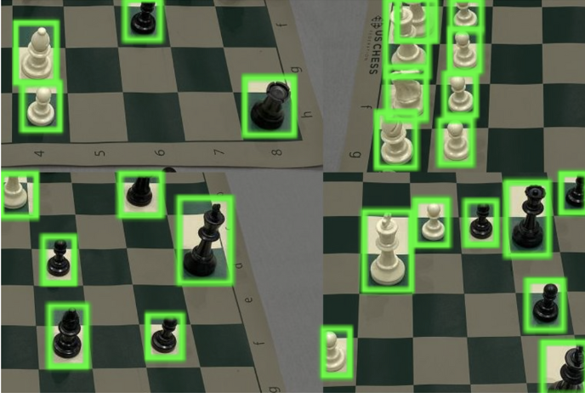
 | Baseline | Improved 1 | Improved 2 | Improved 3
Dataset | 1000 photos: 600 train 200 val (Spain, Estonia) 200 test (Albania, Azerbaijan) | 1000 photos: 600 train 200 val (Spain, Estonia) 200 test (Albania, Azerbaijan) | 2200 photos: 1800 augmented train* 200 val (Spain, Estonia) 200 test (Albania, Azerbaijan) | 2200 photos: 1800 augmented train* 200 val (Spain, Estonia) 200 test (Albania, Azerbaijan)
Epochs | 100 | 100 | 100 | 300
Starting weight | Pretrained weights on COCO 2017
Frozen layers⁺ | 10# | None | 10# | 10#
⁺:YOLOv5l has a total of 267 layers, 46,113,663 parameters
#: the first 10 layers are ‘backbone’ layers, responsible for feature extraction
*:Crop 0-10% zoom, rotate +/-15º, brightness +/-15%, exposure +/-10%, mosaic applied
Example of mosaic
Simulate cropped of objects
Increase the number classes in an image
Increase the number of objects in an image

Slide 14
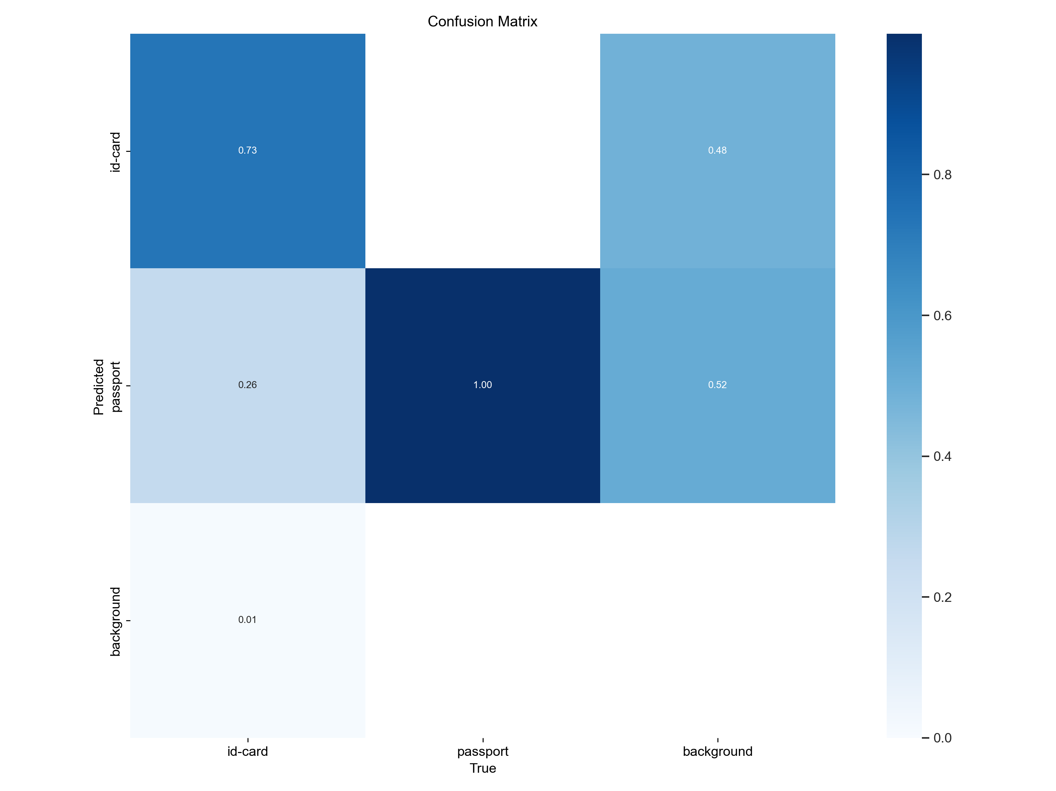
Validation Results
 | Baseline
Dataset | 1000 photos
Epochs | 100
Starting weight | Pretrained weights on COCO 2017
Frozen layers | 10
Training duration | 27min
Also wrongly identify some background as card/passport
27% wrong prediction for ID card

Slide 15
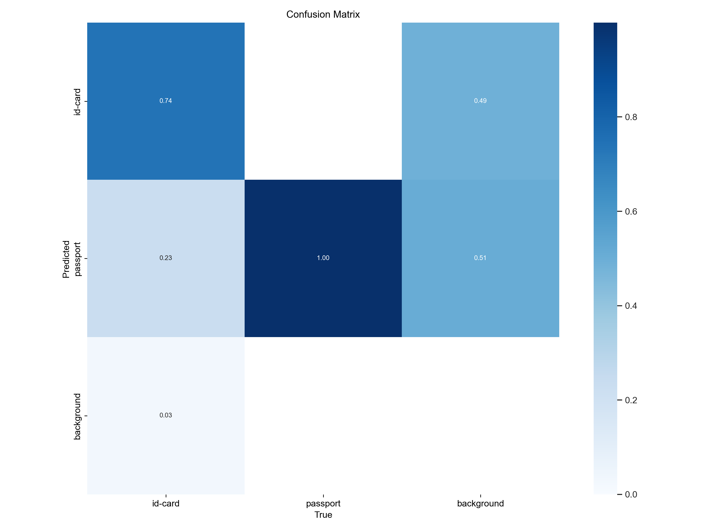
 | Improved 1
Dataset | 1000 photos
Epochs | 100
Starting weight | Pretrained weights on COCO 2017
Frozen layers | None
Training duration | 39min
Similar performance at 46% extra training time (27min vs 39min)

Slide 16
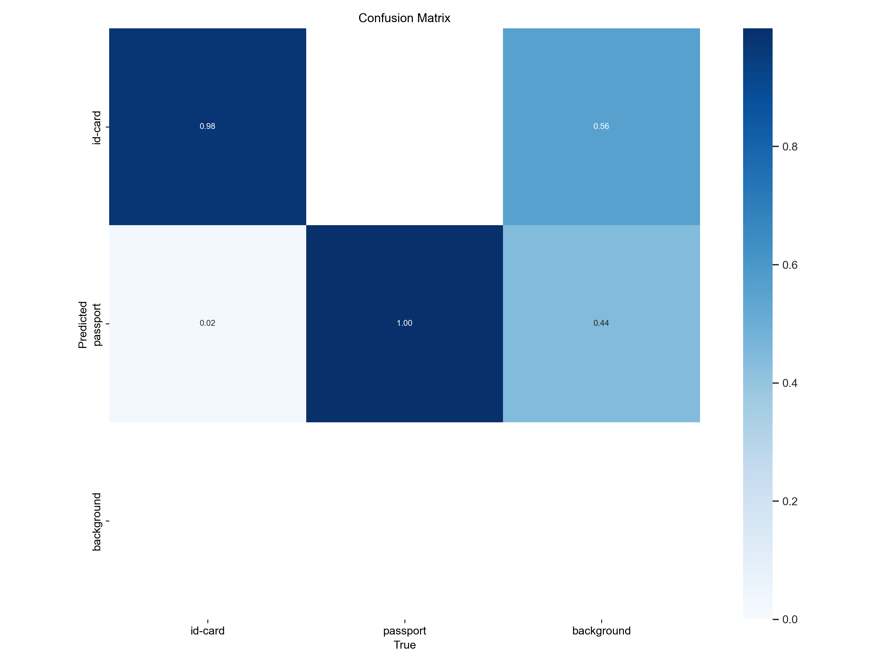
 | Improved 2
Dataset | 2200 photos: 1800 augmented train
Epochs | 100
Starting weight | Pretrained weights on COCO 2017
Frozen layers | 10
Training duration | 1hrs, 17min
Crop 0-10% zoom,
rotate +/-15º,
brightness +/-15%,
exposure +/-10%,
mosaic applied
Much better false-positive rate
Still wrongly identifying some background

Slide 17
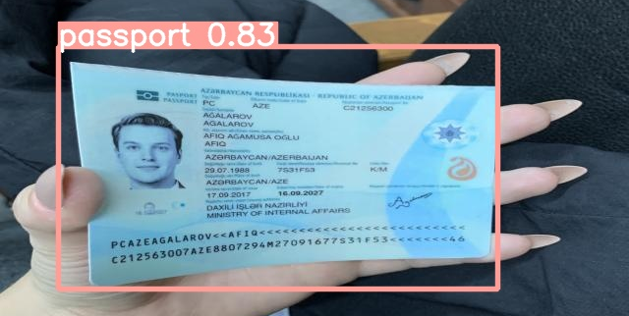
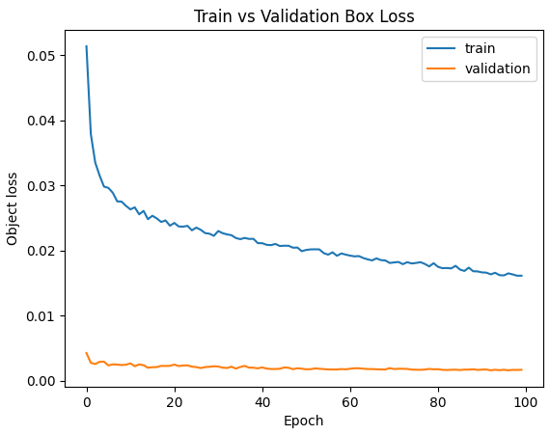
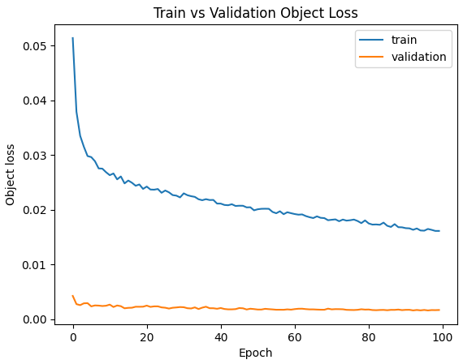
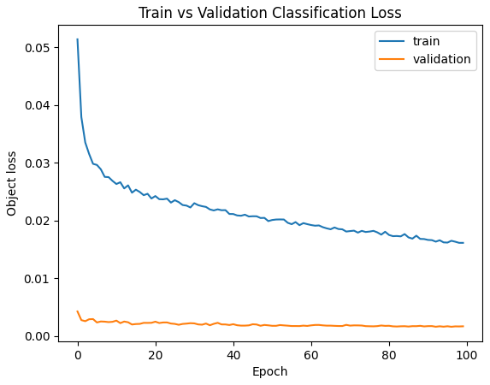
3 losses in object detection:
Object: is there an ID card or passport in the box?
If there is:
Box
Classification: is the object an ID card or passport?
Not close? Let’s do more epochs!

Slide 18
 | Improved 3
Dataset | 2200 photos: 1800 augmented train*
Epochs | 300
Starting weight | Pretrained weights on COCO 2017
Frozen layers | 10
Training duration | 3hrs, 19min
Became perfect @ 163 epochs (result did not improve for the next 100 epochs)
(@ Shilpa, Soon Poh: should I show this??)
Let’s find out for real – Streamlit it!

Slide 19
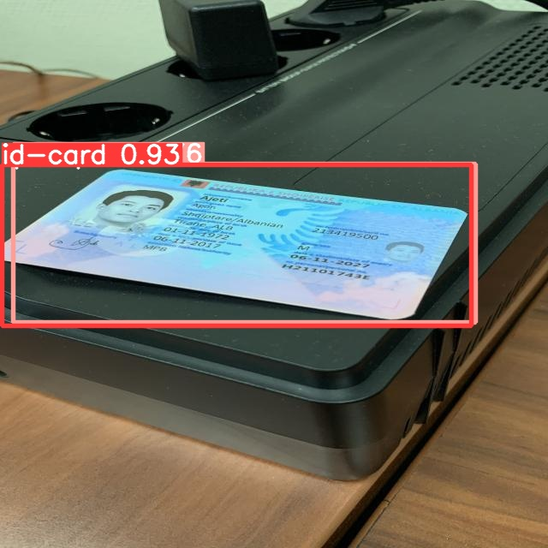
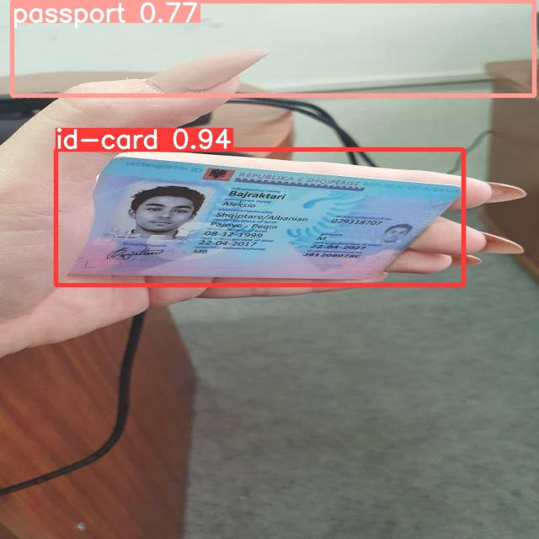
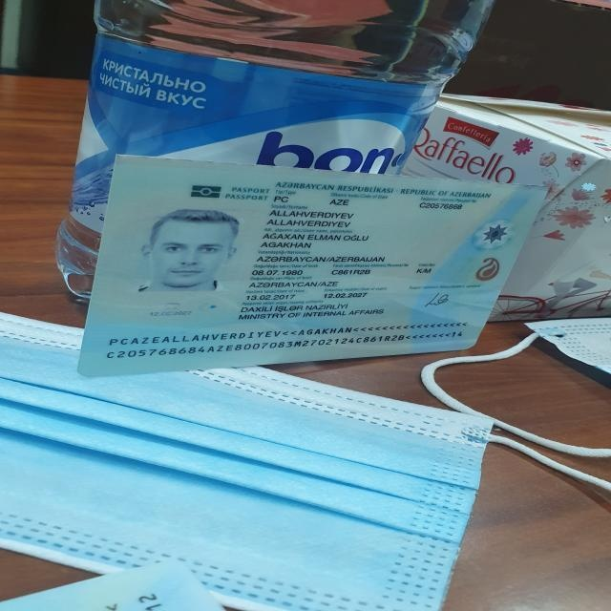
Test Results
 | Baseline |  | Improved 1 |  | Improved 2 |  | Imp100roved 3
Dataset | 1000 photos: 600 train 200 val (Spain, Estonia) 200 test (Albania, Azerbaijan) |  | 1000 photos: 600 train 200 val (Spain, Estonia) 200 test (Albania, Azerbaijan) |  | 2200 photos: 1800 augmented train* 200 val (Spain, Estonia) 200 test (Albania, Azerbaijan) |  | 2200 p0hotos: 1800 au0gmented train* 200 val (Spain, Estonia) 200 test (Albania, Azerbaijan)
Epochs | 100 |  | 100 |  | 100 |  | 300
Starting weight | Pretrained weights on COCO 2017
Frozen layers⁺ | 10# |  | None |  | 10# |  | 10#
Predictions (Confidence >=0.7) | ID: Passport: Cannot find object: Mislabelled ID/passport: Mislabelled background: | 83 100 0 17 0 | ID: 99 Passport: Cannot find object: Mislabelled ID/passport: Mislabelled background: | 98 91 5 6 2 | ID: Passport: Cannot find object: Mislabelled ID/passport: Mislabelled background: | 100 100 0 0 1 | ID: Passport: Cannot find object: Mislabelled ID/passport: Mislabelled background: | 100 100 0 0 0
Example of mislabelled ID/passport
Example of mislabelled background
Example of cannot find object

Slide 20
Progress update (24 Feb 2023)
4x models done!
 | What’s done | What’s next (before next update)
Business case | Pause, focus on technical portion first | Pause, focus on technical portion first
Modelling | Baseline + 3 improved models | Model pruning? E.g. 0.3-0.5 sparsity (dropout) Try streamlit

Slide 21
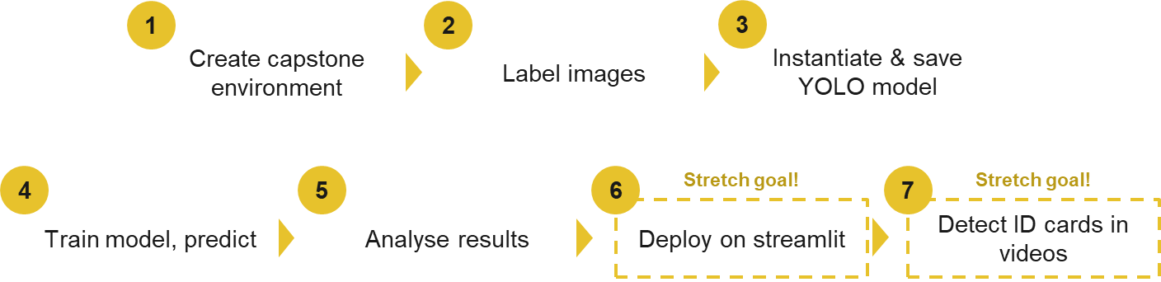
Progress update (27 Feb 2023)
Streamlit done!
X
 | What’s done | What’s next (before next update)
Business case | Paused, focused on modelling | Complete the PPT Rehearse presentation
Modelling | Training dataset EDA Streamlit | Clean up code notebooks Read and understand: Whether to augment validation / test datasets YOLO architecture (backbone, neck, head), 3x losses, developed model limitations and areas for improvement

Slide 22
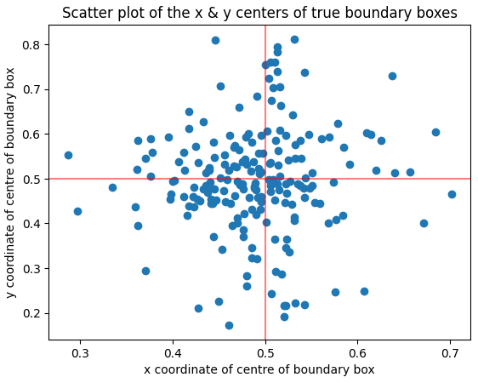
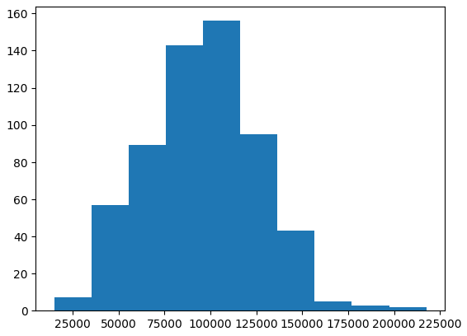
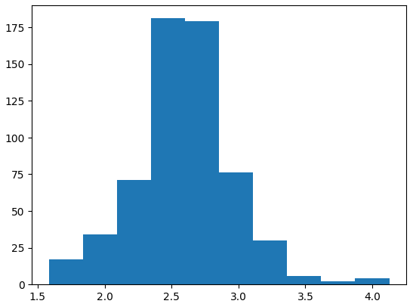
Training Data EDA – ID Cards
 | Scatter plot of location | Boundary box area distribution | Boundary box aspect ratio distribution
Default training data
Augmented training data
Most photos range between 40-55% of a 640x640 pixel photo
Weakness: corners
Weakness: zoomed in photos
Hover around normal aspect ratio of 2.6

Slide 23
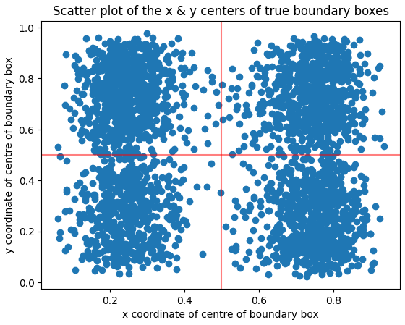
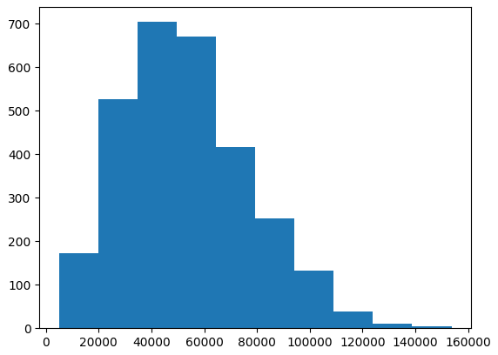
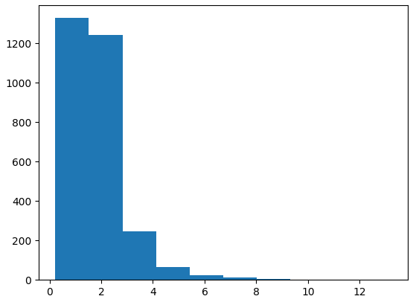
Training Data EDA – ID Cards
 | Scatter plot of location | Boundary box area distribution | Boundary box aspect ratio distribution
Default training data
Augmented training data
Distribution shifted left due to introduction of cropped images → more robust
Rotation, mosaic increased range → more robust to rotation/cropping
Better distribution due to mosaic

Slide 24
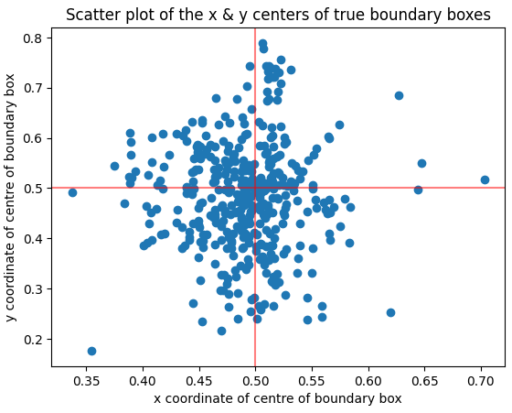
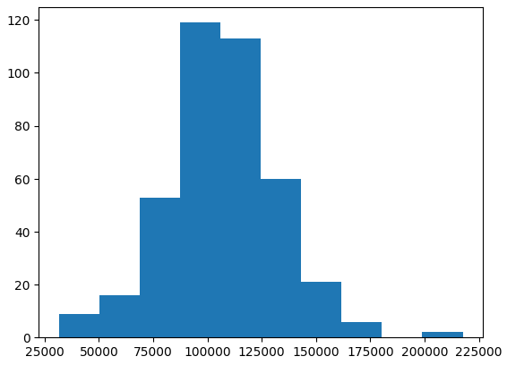
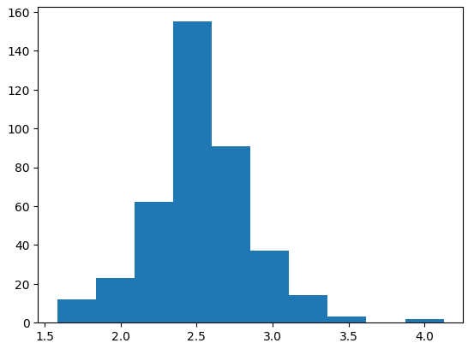
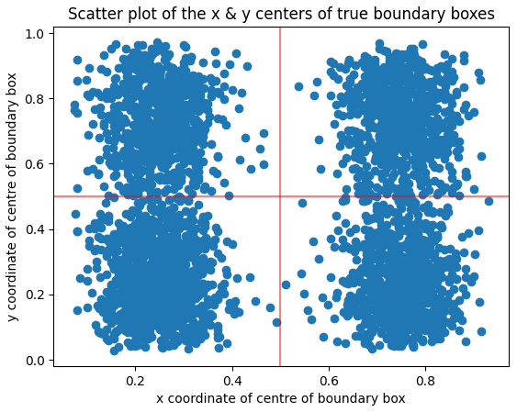
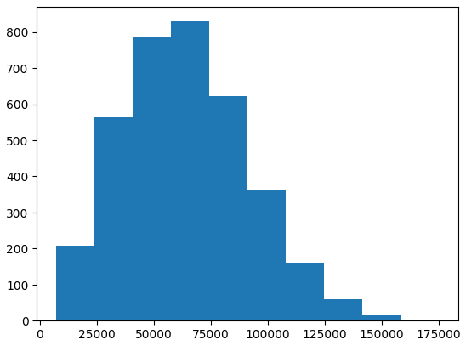
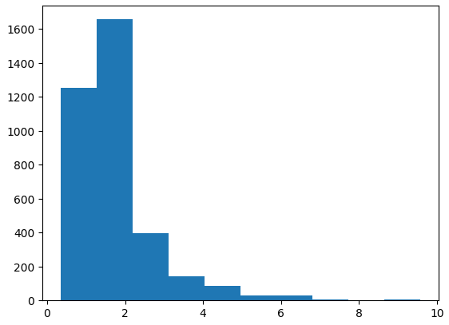
Training Data EDA – Passport
Similar results as ID Cards
 | Scatter plot of location | Boundary box area distribution | Boundary box aspect ratio distribution
Default training data
Augmented training data
Better distributed across the entire photo
Increase robustness due to addition of cropped samples
more robust to rotation/cropping

Slide 25
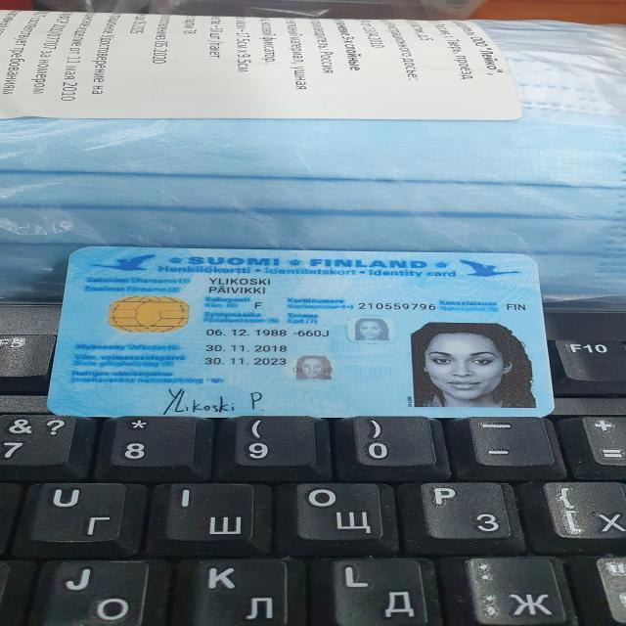
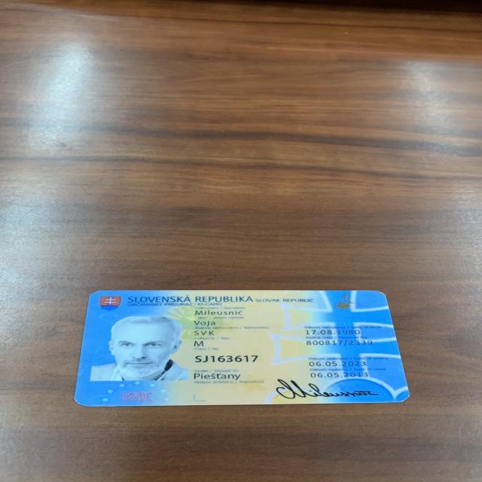
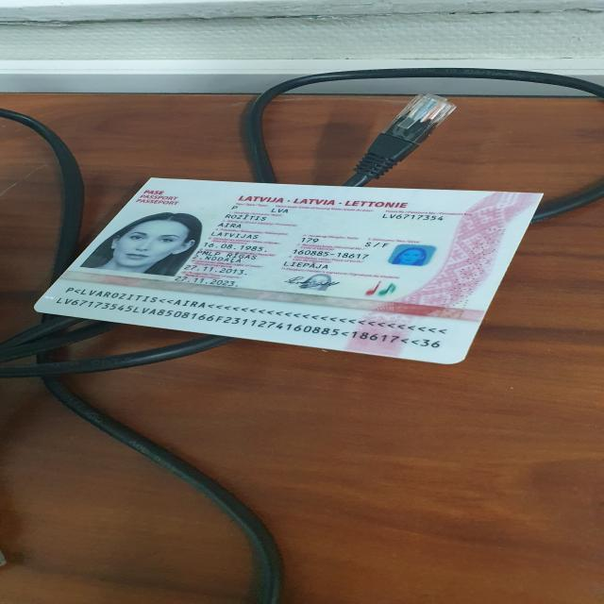
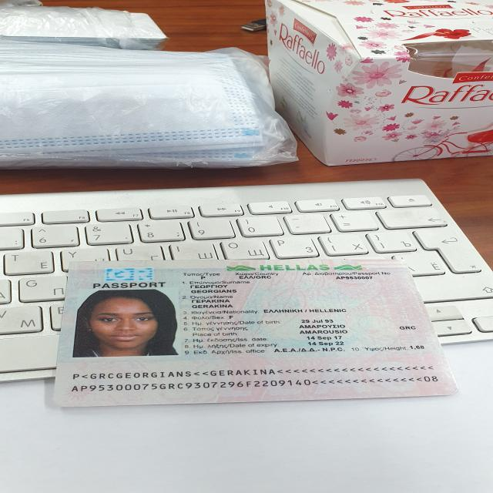
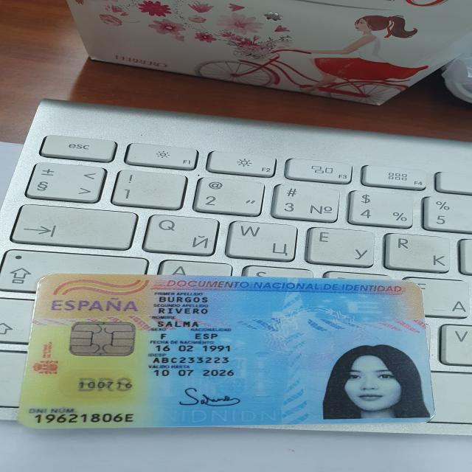
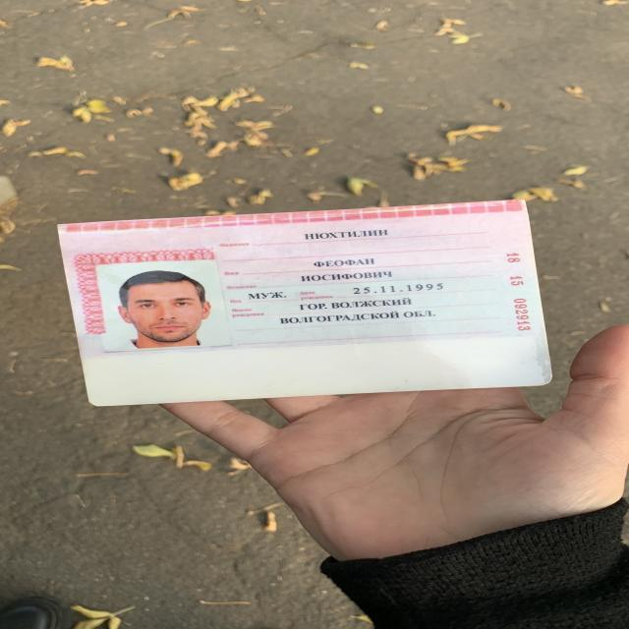
Training Data EDA – Colour Scheme
ID Cards – Blue, Yellow
Passports – Pink, White

Slide 26
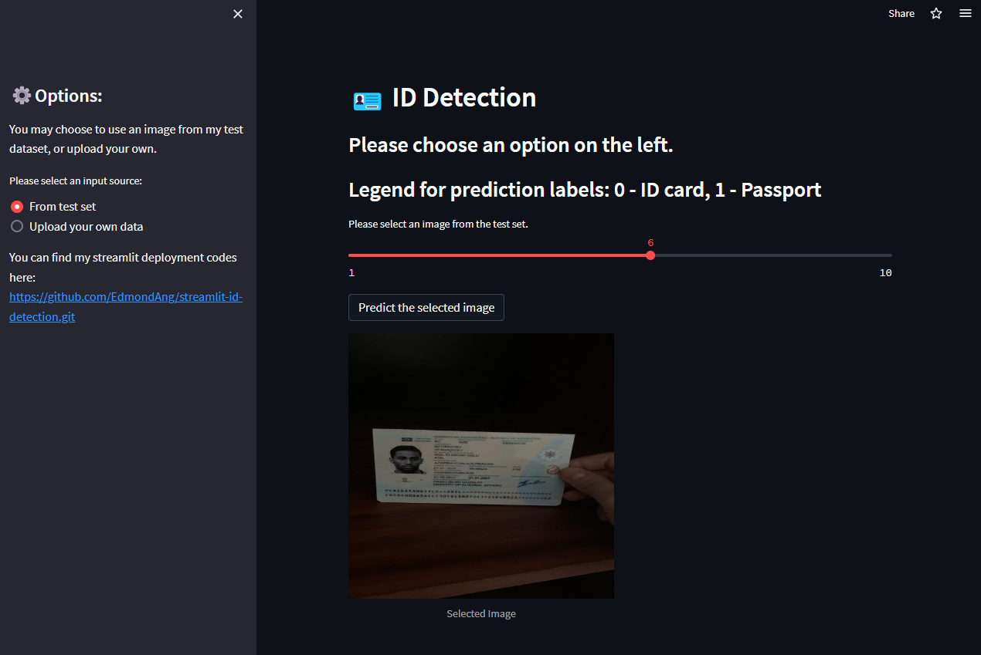
Streamlit – 2 Modes: From Prepared Test Set

Slide 27
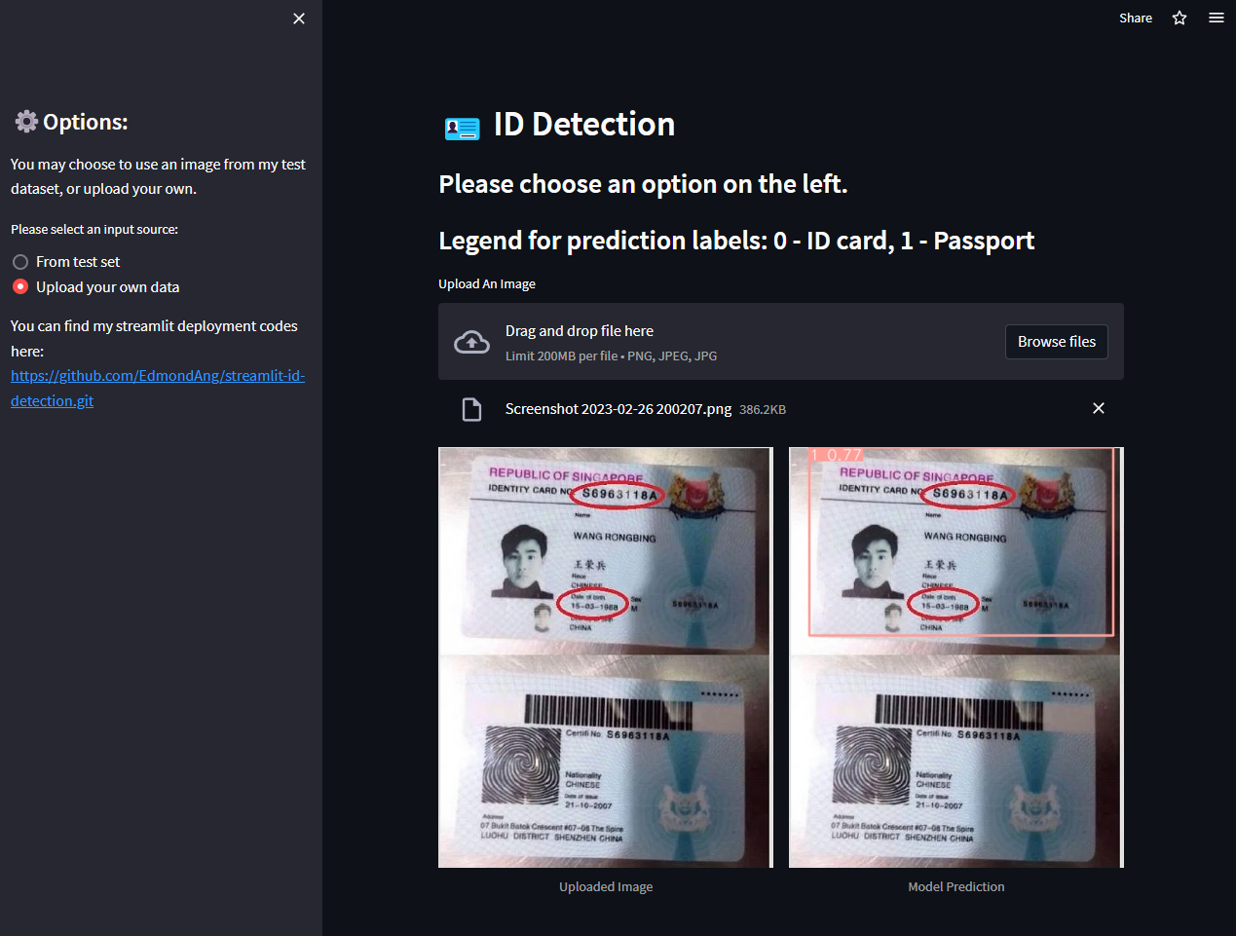
Streamlit – 2 Modes: Upload Your Own Data

Slide 28
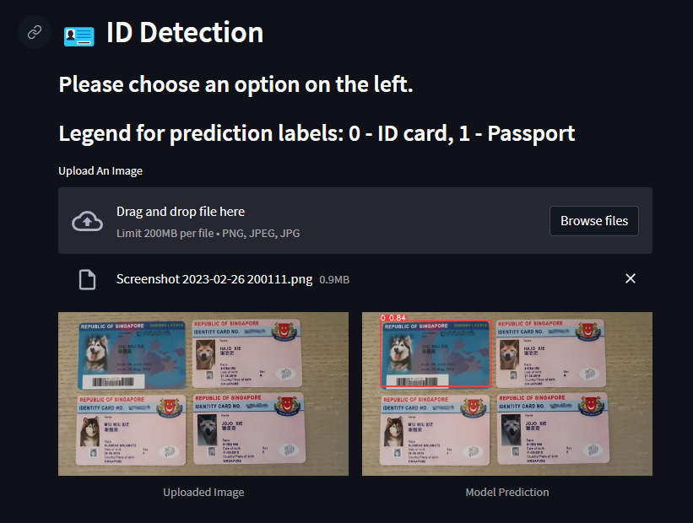
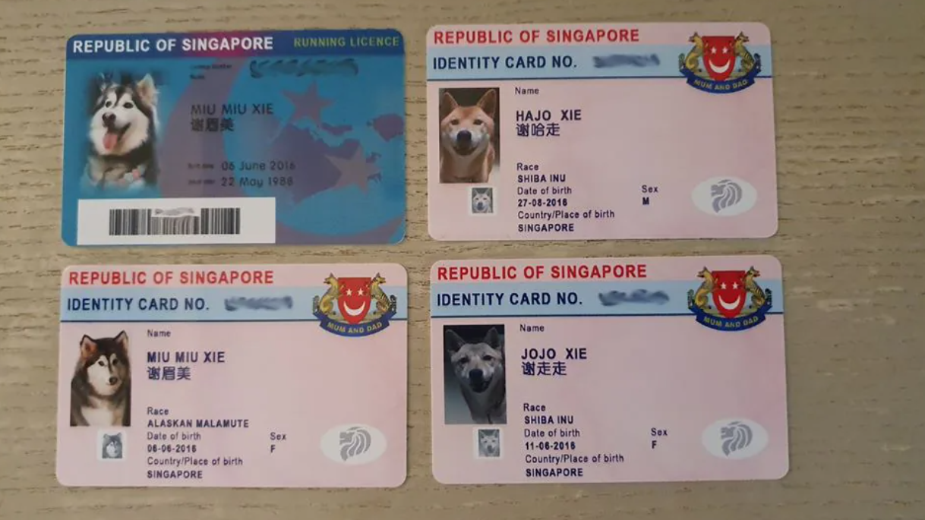
Streamlit – Trial 1
Identified only the blue card – because of training dataset!

Slide 29
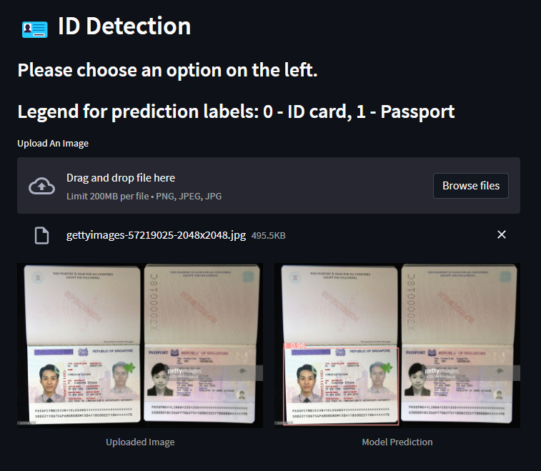
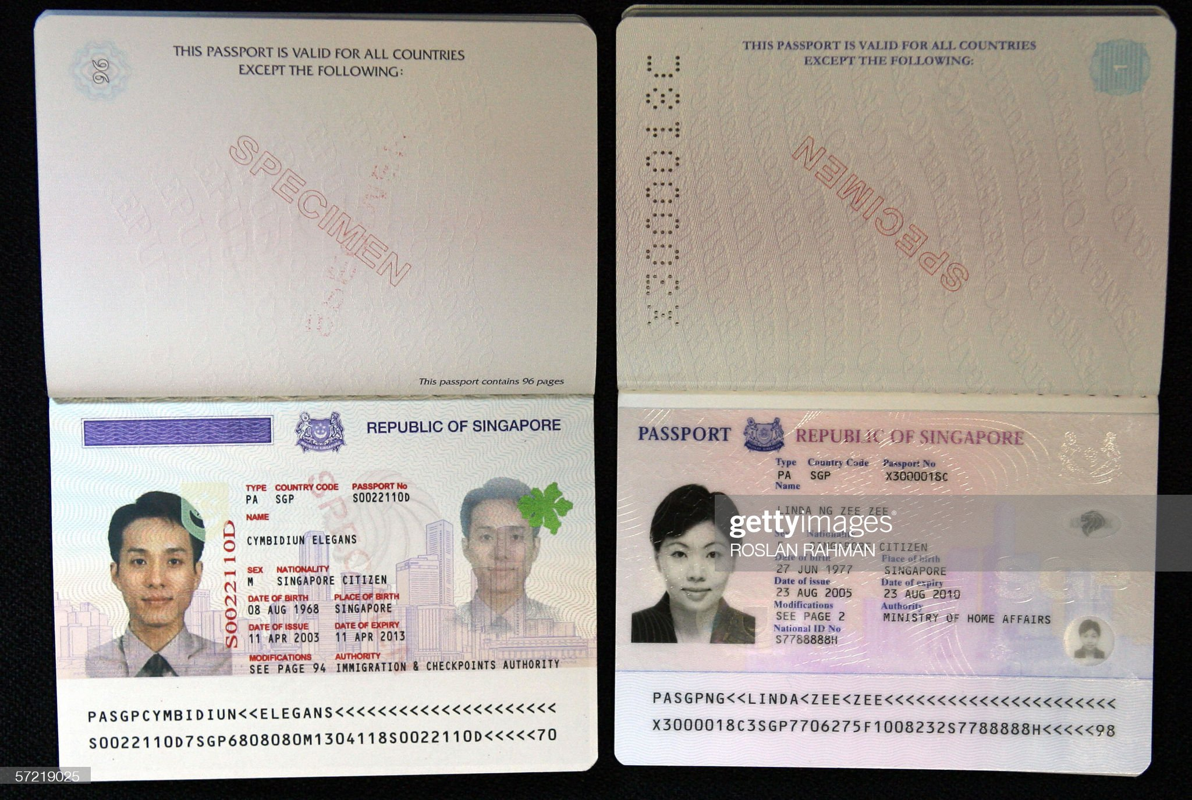
Streamlit – Trial 2
Identified the left, not the right passport – because of a grey overlay?

Slide 30
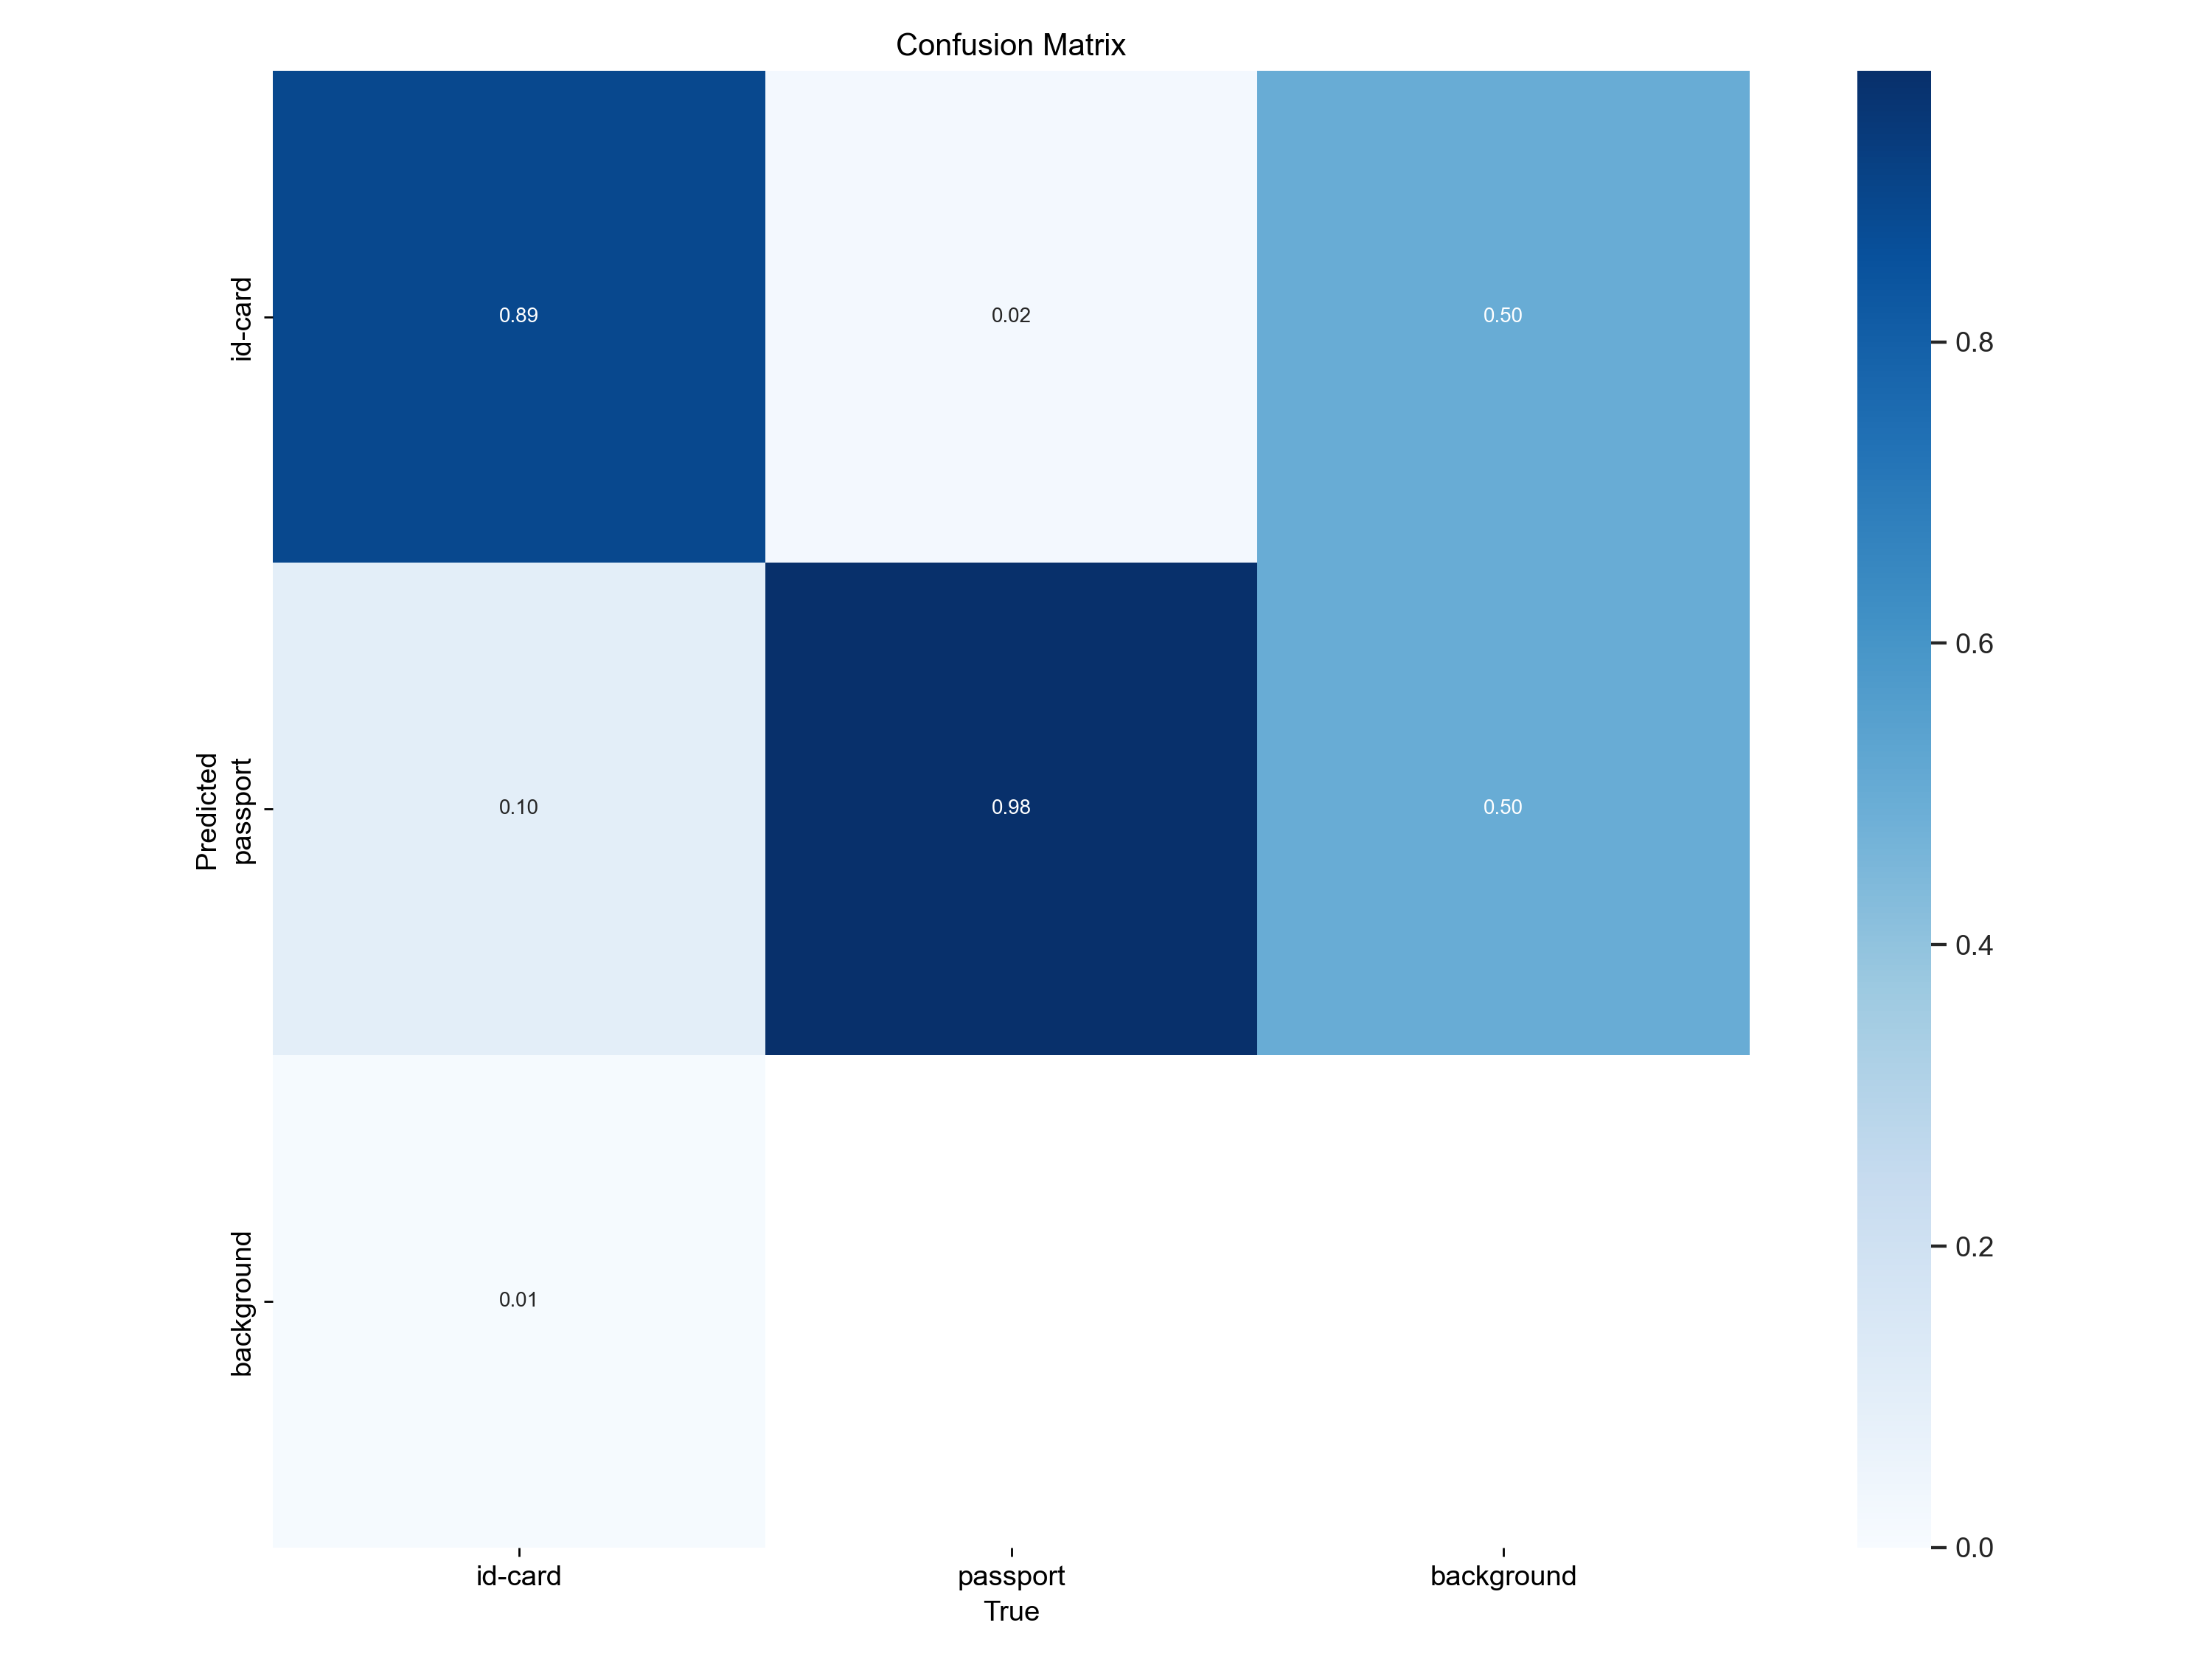
Validation Results
2% wrong prediction for passport
 | Baseline
Dataset | 1000 photos
Epochs | 100
Starting weight | Pretrained weights on COCO 2017
Frozen layers | 10
Training duration | 29min
Also wrongly identify some background as card/passport
11% wrong prediction for ID card

Slide 31
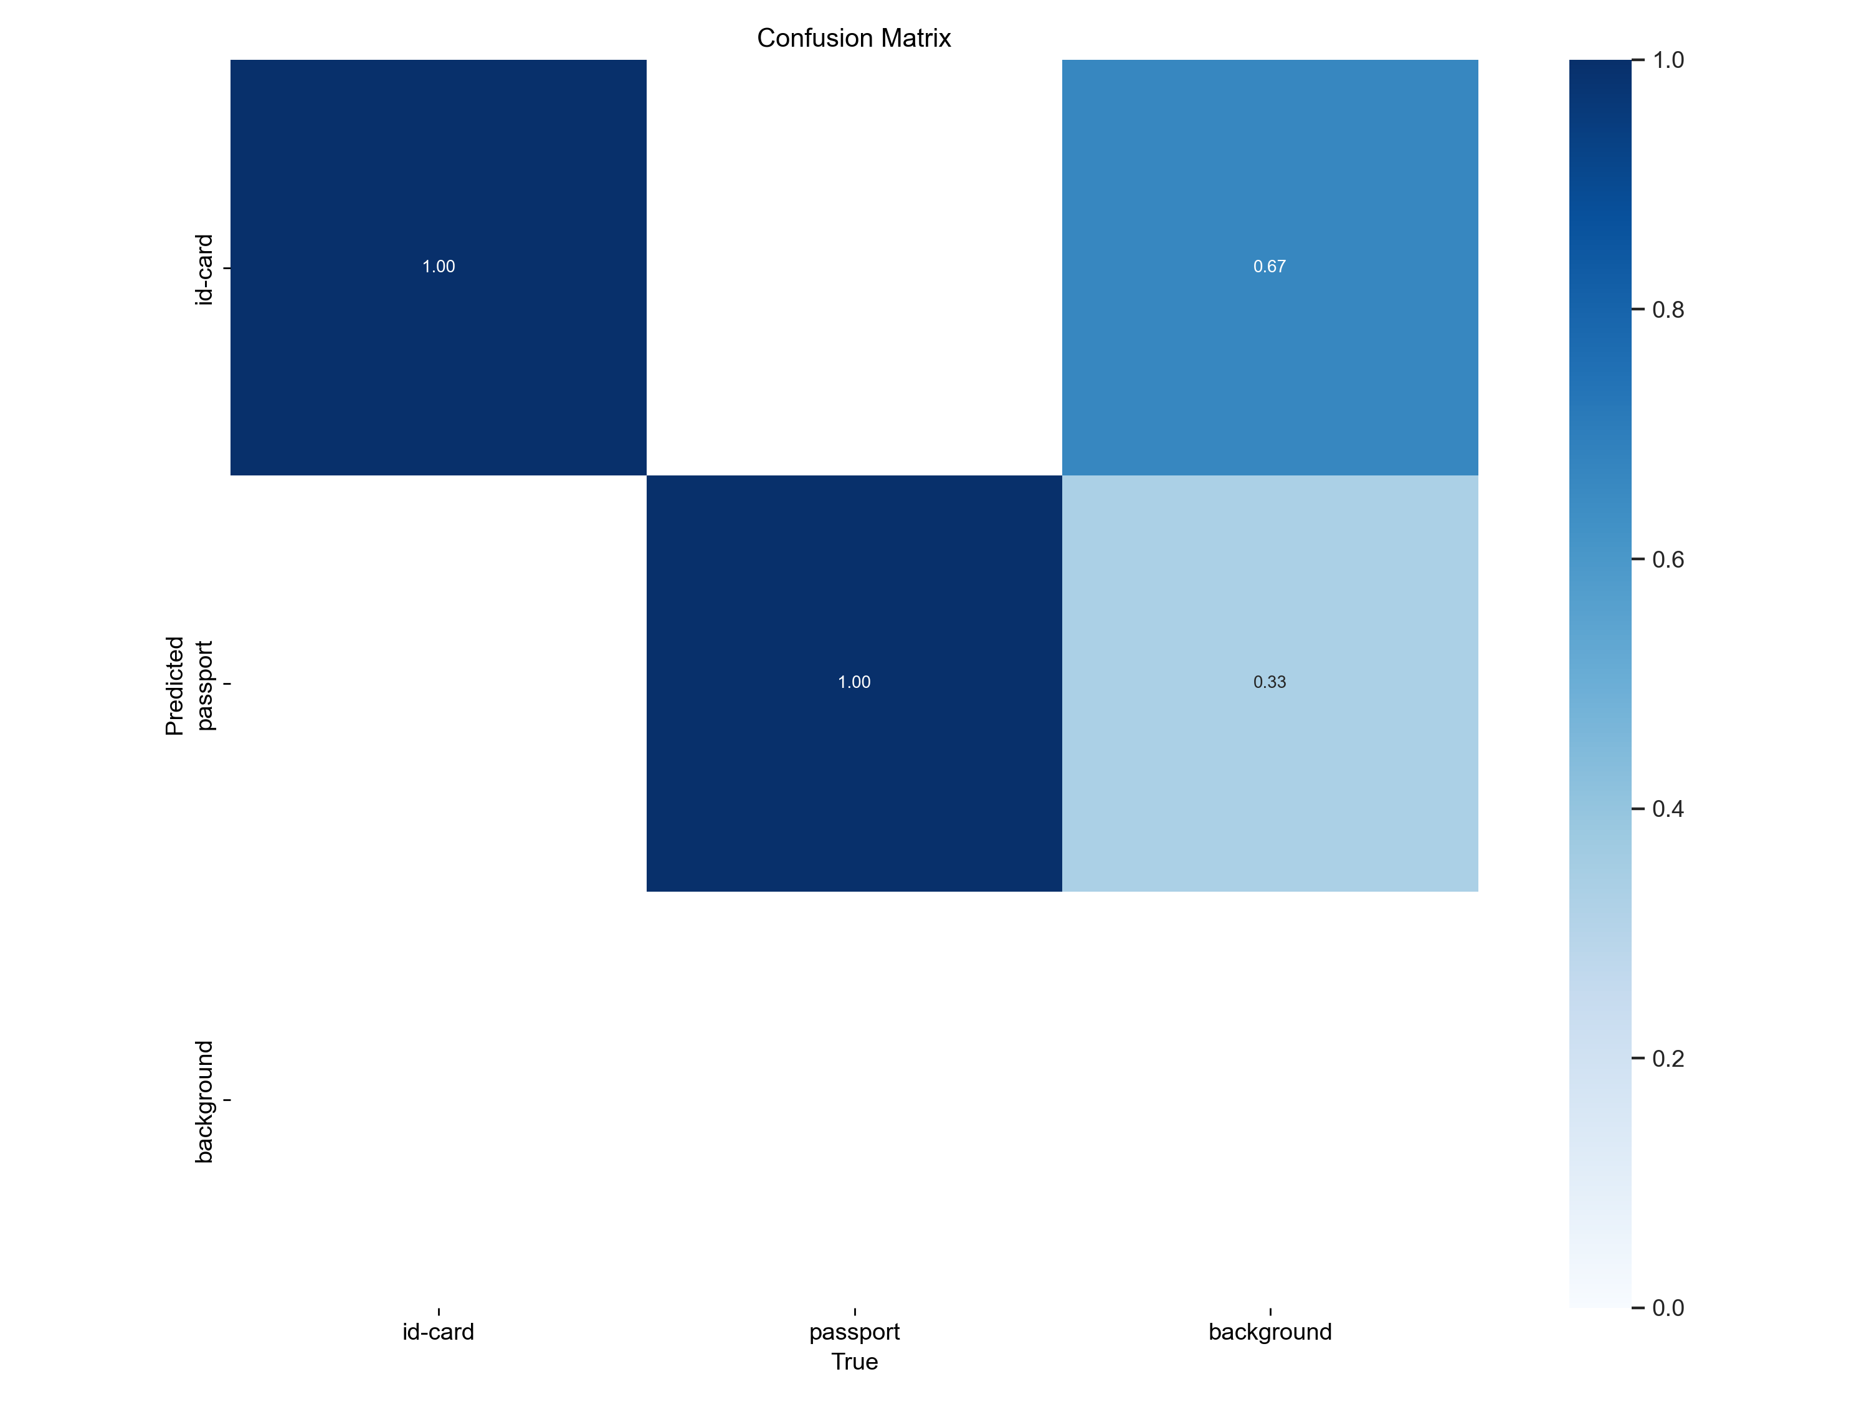
 | Improved 1
Dataset | 1000 photos
Epochs | 100
Starting weight | Pretrained weights on COCO 2017
Frozen layers | None
Training duration | 39min
Similar performance at 46% extra training time (27min vs 39min)

Slide 32
 | Improved 2
Dataset | 2200 photos: 1800 augmented train
Epochs | 100
Starting weight | Pretrained weights on COCO 2017
Frozen layers | 10
Training duration | 1hrs, 17min
Crop 0-10% zoom,
rotate +/-15º,
brightness +/-15%,
exposure +/-10%,
mosaic applied
Much better false-positive rate
Still wrongly identifying some background

Slide 33
Test Results
 | Baseline |  | Improved 1 |  | Improved 2
Dataset | 1000 photos: 600 train 200 val (Spain, Estonia) 200 test (Albania, Azerbaijan) |  | 1000 photos: 600 train 200 val (Spain, Estonia) 200 test (Albania, Azerbaijan) |  | 2200 photos: 1800 augmented train* 200 val (Spain, Estonia) 200 test (Albania, Azerbaijan)
Epochs | 100 |  | 100 |  | 100
Starting weight | Pretrained weights on COCO 2017
Frozen layers⁺ | 10# |  | None
Predictions (Confidence >=0.7) | ID: Passport: Cannot find object: Mislabelled ID/passport: Mislabelled background: | 96 97 0 7 0 | ID: 99 Passport: Cannot find object: Mislabelled ID/passport: Mislabelled background: | 95 99 0 6 0 | ID: Passport: Cannot find object: Mislabelled ID/passport: Mislabelled background: | 100 100 0 0 1
Example of mislabelled ID/passport
Example of mislabelled background
Example of cannot find object

Slide 34
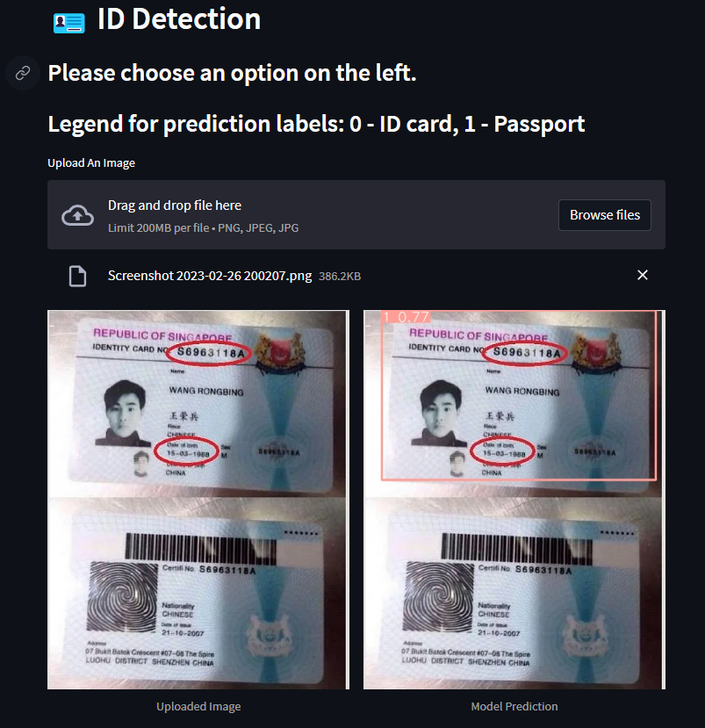
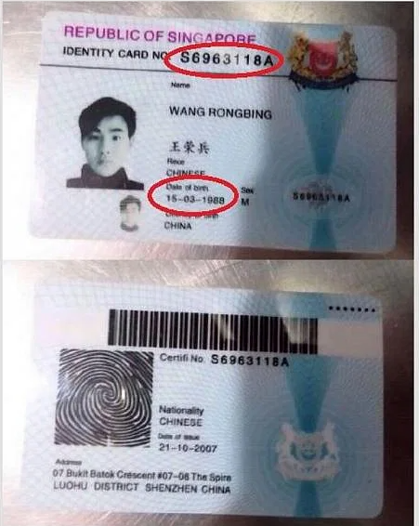
Streamlit – Trial 3
Identified blue PR card as passport – because of training dataset!

Slide 35
Project Workflow
Still optimistic!
1
2
3
Create capstone environment
Label images
Instantiate & save YOLO model
4
5
Stretch goal!
Stretch goal!
6
7
Train model, predict
Analyse results
Deploy on streamlit
Detect ID cards in videos

